Slide 1
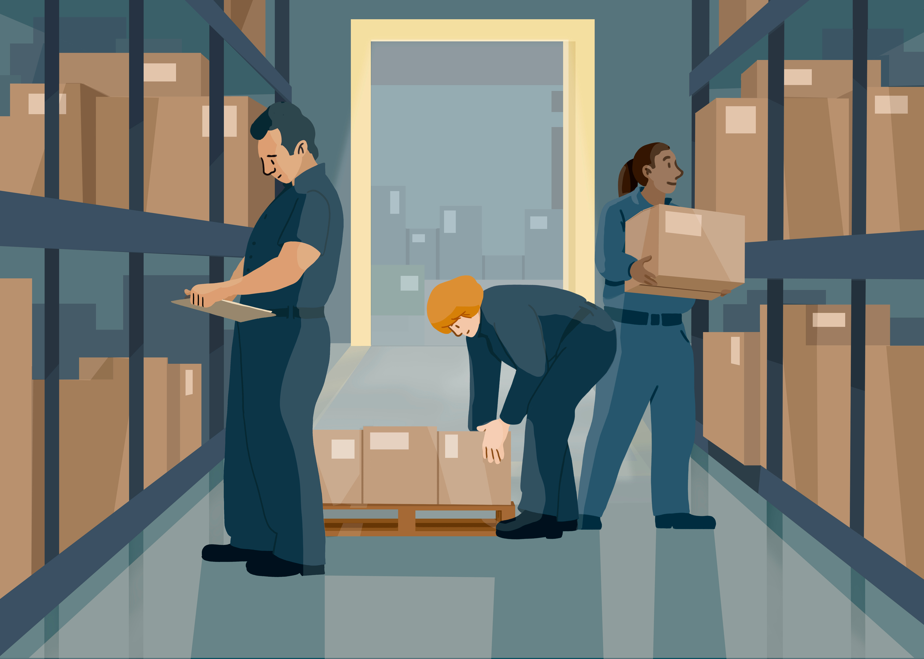
Course Project Report Retail Store Inventory Forecasting
1
Group – 007
Team Members
Sandeep Kaur
Zih-Han- Shen
Ting- Yu- Chen
Khushi Patel
Maurya

Slide 2
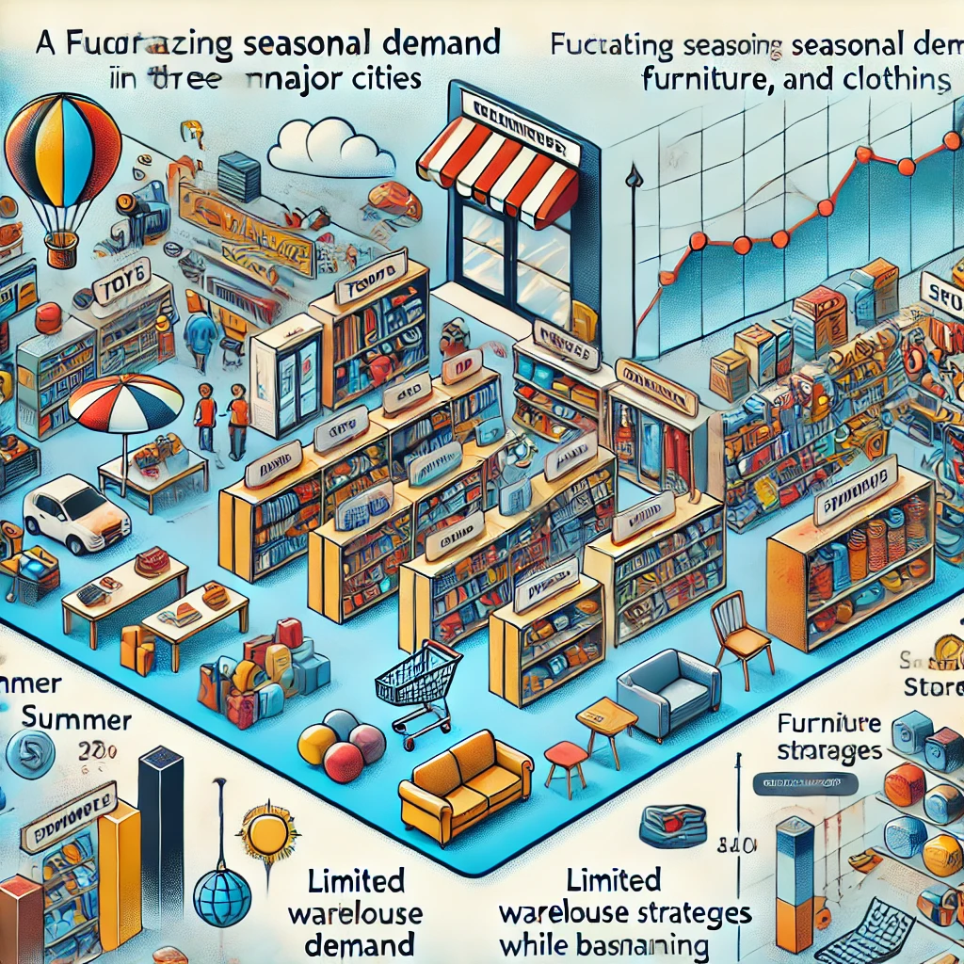
Aura Retail is a small family-owned chain of department stores operating in three major cities. The company sells products across five categories: Toys, Electronics, Groceries, Furniture, and Clothing. ABC Retail faces challenges in managing inventory levels and pricing strategies across its diverse product range. Key problems Aura Retail faces include Seasonal demand fluctuations affecting inventory needs Varying profit margins across product categories Limited storage space in their warehouses Balancing stock levels to meet customer demand without overstocking Determining optimal discount strategies to boost sales without sacrificing profitability. Aura Retail aims to optimize its inventory management and pricing strategies to maximize profit while minimizing holding costs. The company has collected 5 months of sales and inventory data and seeks to develop a data-driven approach to address these challenges.

Slide 3
Executive Summary……………………………………………………………………………………………………………………4
Objective…………………………………………………………………………………………………………………………………5
Business Problem………………………………………………………………………………………………………………………6
Methodology…………………………………………………………………………………………………………………………….7
Optimization Model ………………………………………………………………...........................................................8- 11
Appendix –
Excel Implementation…………………………………………………………………………………………………………….12 – 13
Charts
Data Analysis and Results…………………………………………………………………………………………......................14 - 16
Conclusion…………………………………………………………………………………………………………………………………17-18
Recommendation and Future scope…………………………………………………………………………………………………. 19

Slide 4
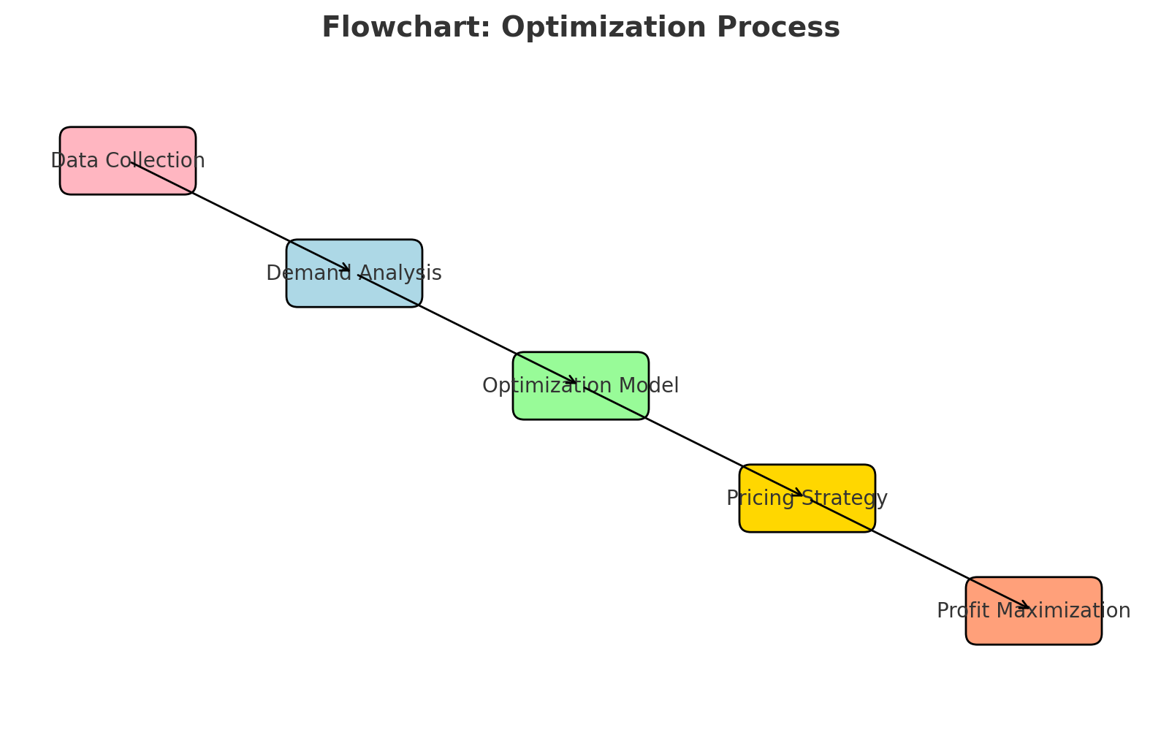
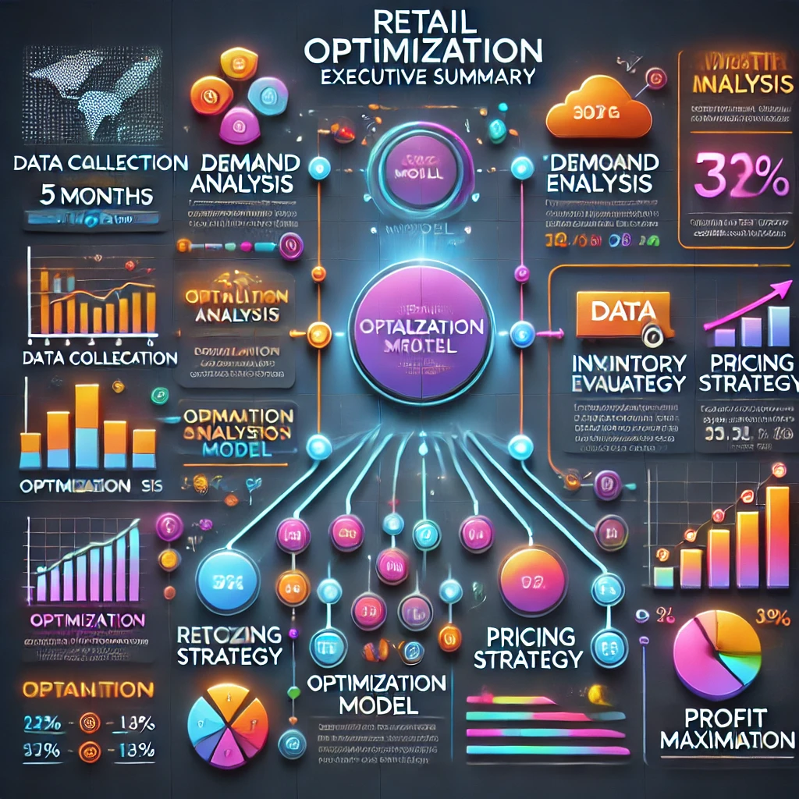
Executive Summary
This project applies optimization techniques to address inventory management and pricing challenges for a retail store. The store operates across five product categories: Toys, Electronics, Groceries, Furniture, and Clothing. Using data collected over a 5-month period, we developed a mathematical model to optimize restock quantities and discount pricing strategies, aiming to maximize profit while considering demand fluctuations and holding costs.

Slide 5
Objective
The primary objective is to optimize the store's inventory management and pricing strategy to maximize profit, demonstrating the practical application of optimization methods to a real-world business problem. This involves Developing a mathematical model that captures the complexities of inventory management across multiple product categories.
Implementing the model using Excel Solver to find optimal solutions.
Providing actionable insights to improve the store's operational efficiency and profitability.
Demonstrating how advanced analytical techniques can be applied to solve practical retail challenges.

Slide 6
Business Problem
The retail store encounters several key challenges in managing its inventory and pricing strategies
Optimal Restock Quantities: The store struggles to determine the ideal amount of each product category to restock, balancing the need to meet customer demand with the risk of overstocking.
Discount Pricing Strategy: Setting effective discount prices is challenging, as the store needs to stimulate demand without significantly impacting profit margins.
Inventory Level Management: Maintaining appropriate inventory levels is crucial to minimize holding costs while ensuring that popular items are always available for customers.
Revenue and Profit Maximization: The store aims to maximize revenue and profit across all product categories, which requires a careful analysis of sales data and market trends.
Demand Fluctuations: The business faces difficulties in accurately forecasting demand fluctuations due to seasonality and changing consumer preferences, complicating inventory planning.
These challenges necessitate a robust optimization approach to enhance inventory management and pricing strategies, ultimately improving the store's financial performance and customer satisfaction

Slide 7
Methodology
Overview:
The project employs linear programming and data analysis techniques to optimize inventory and pricing decisions for a retail store across five product categories: Toys, Electronics, Groceries, Furniture, and Clothing.
Data Collection:
Data was collected from the store's inventory management system over a 5-month period, including:Initial stock levels
Monthly restock quantities
Units sold
Regular and discount prices
Costs (unit cost and holding cost)

Slide 8
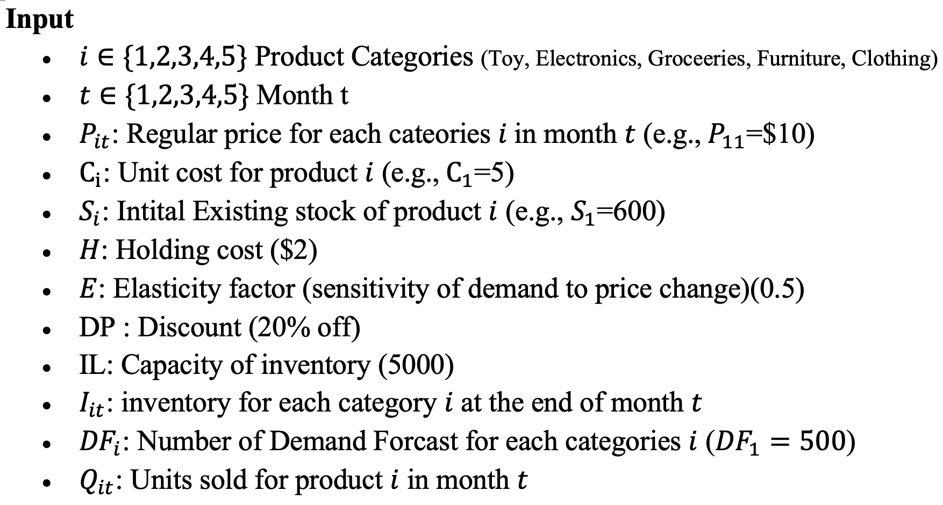
Optimization Model

Slide 9
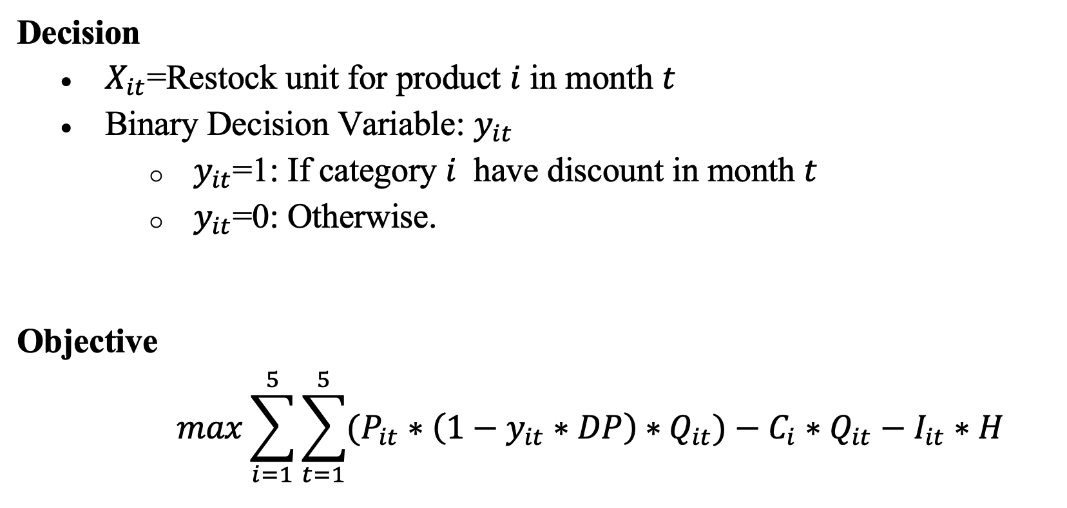

Slide 10
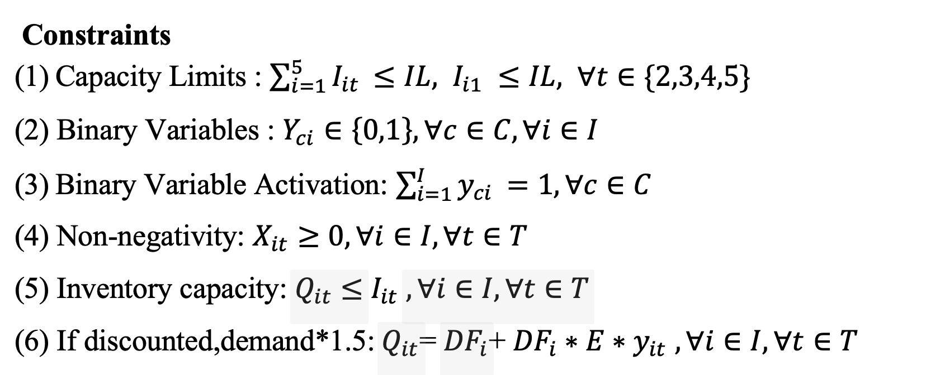

Slide 11
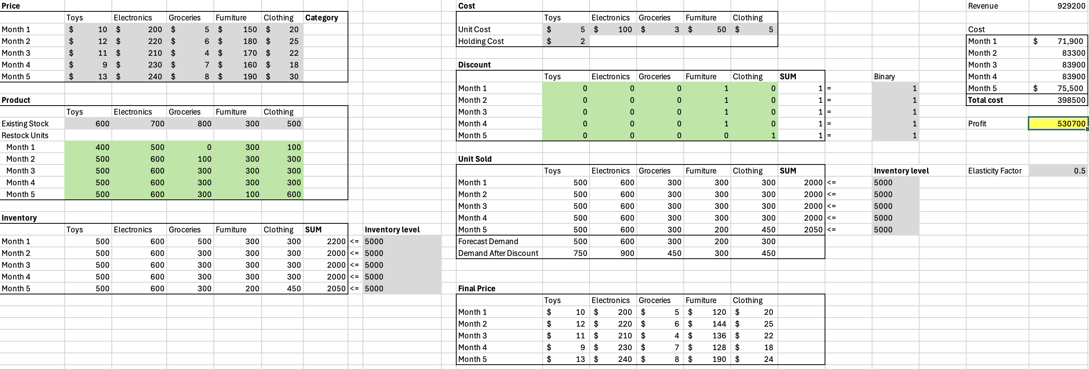

Slide 12
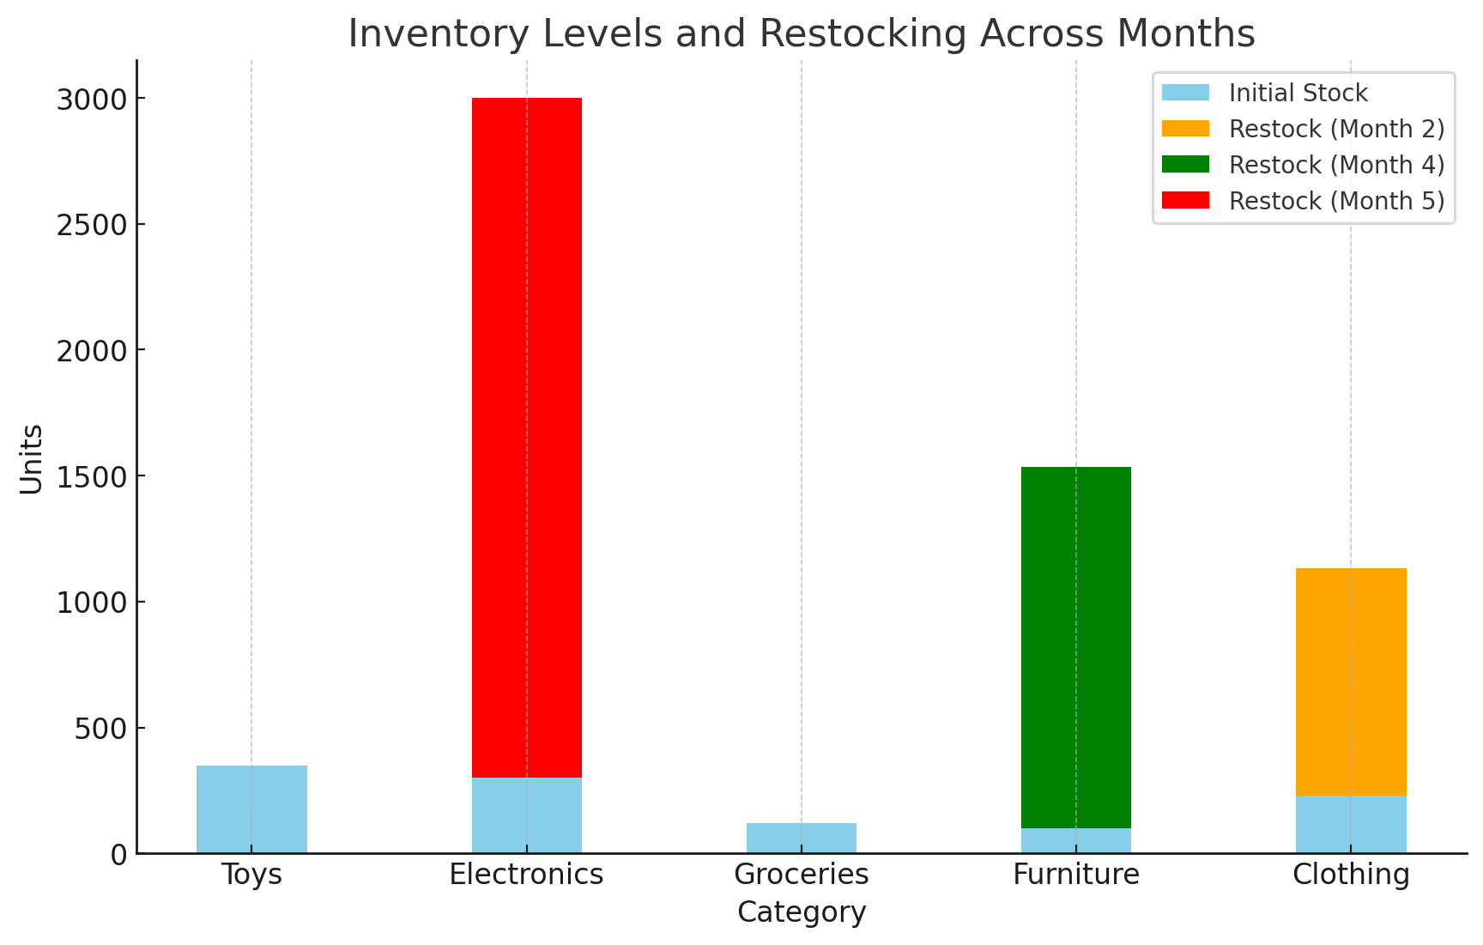
The initial stock allocation prioritizes Toys and Electronics, reflecting their demand or cost dynamics. Significant restocking occurred in Month 2 (Clothing: 901 units), Month 4 (Furniture: 1,433 units), and Month 5 (Electronics: 2,700 units), highlighting targeted replenishment based on demand surges. Electronics' large restocking suggests its importance as a revenue driver. A predictive restocking strategy could further optimize inventory levels and prevent stockouts.

Slide 13
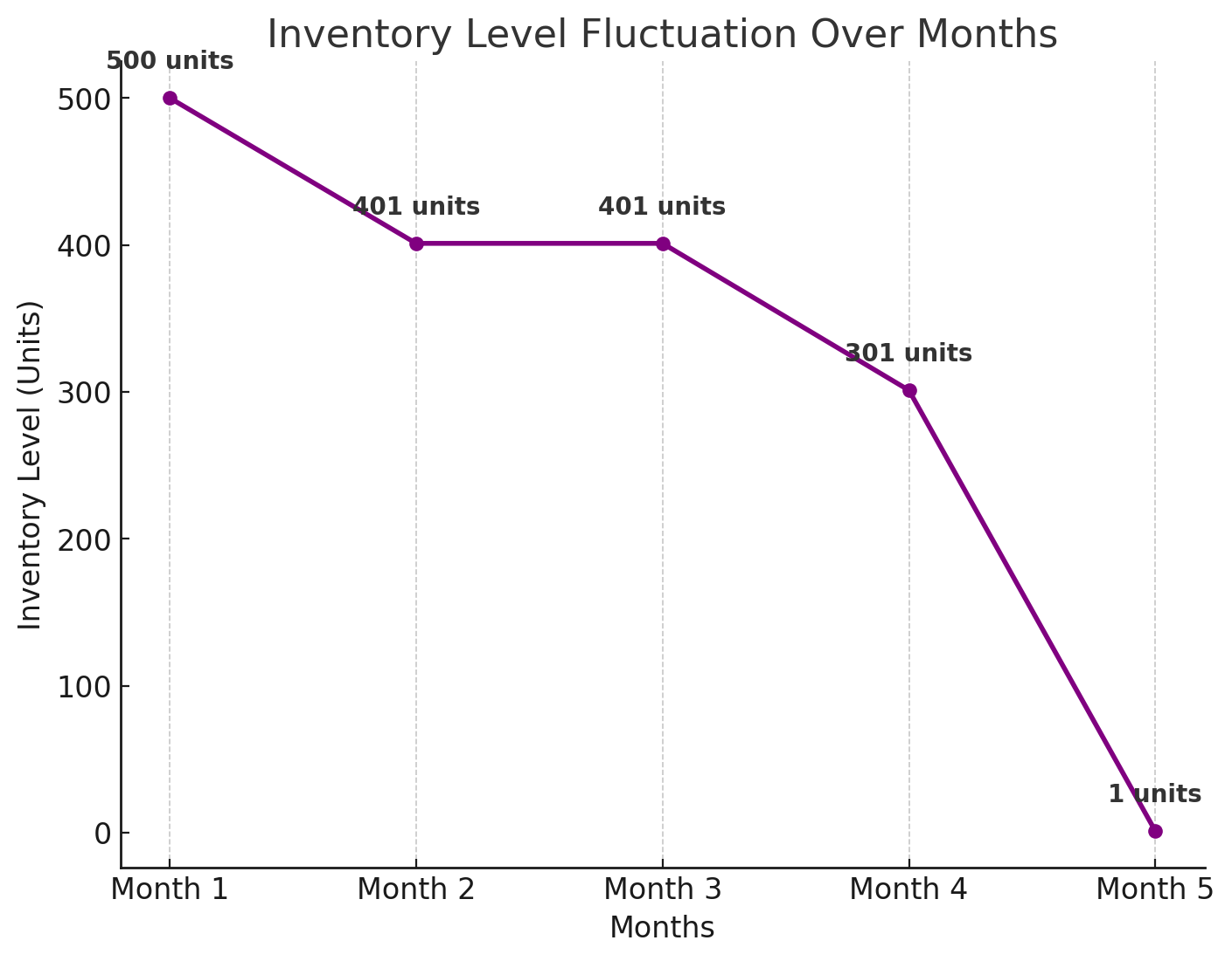
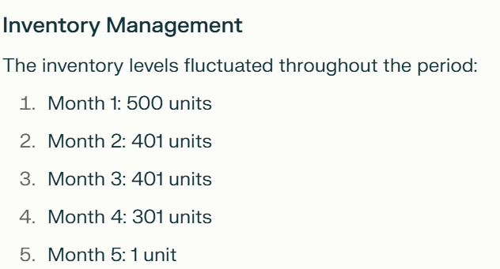
Revenue Analysis Total revenue generated over the 5-month period: $1,102,989
Cost Analysis Total cost incurred: $387,625
Profit Analysis Total profit: $693,274
Inventory levels were optimized, reducing from 500 units in Month 1 to 1 unit by Month 5, indicating efficient stock management.

Slide 14
Conclusions
Pricing Strategy: The discount pricing strategy was effective in stimulating demand, particularly for Electronics in Month 5, which generated the highest monthly revenue.
Inventory Management: The store maintained relatively stable inventory levels for the first four months but significantly reduced inventory by Month 5. This suggests a potential need for more frequent restocking to avoid stockouts.
Product Performance: Electronics: Highest contributor to sales and revenue
Furniture: Second-highest in units sold, indicating strong demand
Clothing: Significant sales in Month 2, possibly due to a promotional event
Toys and Groceries: Lower sales volumes, may require reevaluation of inventory and pricing strategies

Slide 15
Profit Margin: The overall profit margin is approximately 67.5%, indicating a healthy business model. However, there's room for improvement in cost management and pricing optimization.
Demand Forecasting: The store should focus on improving demand forecasting accuracy to better align inventory levels with expected sales, reducing holding costs and minimizing lost sales opportunities.
Category Management: Consider reallocating resources from lower-performing categories (Toys and Groceries) to higher-performing ones (Electronics and Furniture) to maximize overall profitability.
Seasonal Trends: The data suggests potential seasonal trends, with higher sales in later months. The store should analyze these patterns to prepare for future demand fluctuations.
Restock Strategy: Implement a more dynamic restocking strategy that responds quickly to changes in demand, particularly for high-performing categories like Electronics and Furniture.
In conclusion, while the store has achieved significant profit, there are opportunities for improvement in inventory management, pricing strategy, and demand forecasting. By optimizing these areas, the store can potentially increase its revenue and profitability in future periods.

Slide 16

Recommendations and Future Scope
Dynamic Pricing and Discounts:
Implement data-driven, real-time pricing strategies to maximize profit during peak seasons or high-demand periods. Continue offering targeted discounts on high-performing categories like Electronics and Furniture to drive demand and revenue.
Demand Forecasting Enhancement:
Invest in advanced forecasting tools, such as machine learning models, to predict seasonal trends and consumer behavior more accurately. This will help align inventory levels with demand, reducing stockouts and minimizing holding costs.
Inventory Optimization:
Develop a dynamic restocking strategy that allows for more frequent replenishment, especially for high-demand products like Electronics. This will prevent last-minute bulk restocking and ensure consistent stock availability.
Category Reallocation:
Shift focus and resources from lower-performing categories (Toys and Groceries) to higher-performing ones (Electronics and Furniture). Consider reducing inventory for underperforming items while optimizing pricing strategies to improve sales.
Cost Management Improvements:
While the profit margin is strong at 67.5%, further cost reduction opportunities exist in areas like warehousing and transportation. Explore automation and better vendor negotiations to reduce costs further.
Promotional Planning:
Analyze the impact of promotional events, such as the spike in Clothing sales during Month 2, and strategically plan similar campaigns for other product categories to boost sales during off-peak periods.
Seasonal Trends Analysis:
Use historical data to identify and prepare for seasonal trends more effectively. Stock higher quantities of Electronics and Furniture before anticipated demand spikes in later months.
Scalability and Expansion:
Scale the current optimization model to apply across all store locations. Future expansions can benefit from a centralized, data-driven inventory and pricing strategy.
By incorporating these recommendations, the store can enhance its profitability, operational efficiency, and customer satisfaction, ensuring sustainable growth in the competitive retail landscape.

